Slide 1
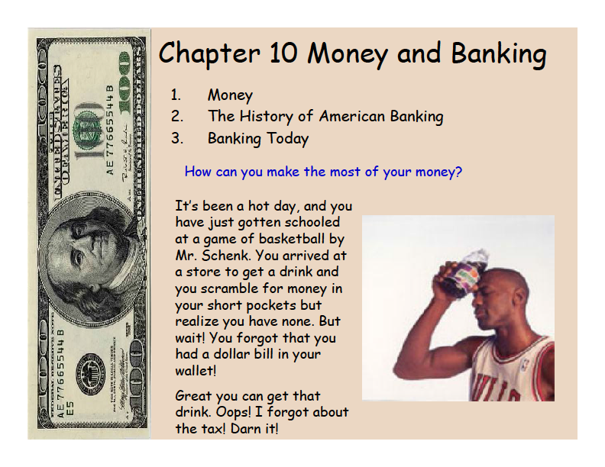
Coach Ferrell.

Slide 4
Medium of Exchange
  MEASURE VALUE during an exchange

Slide 5
Unit of Account
  COMPARE VALUE of goods

Slide 6
Store of Value
  KEEP VALUE if saved, not spent

Slide 8
Durability
  It should not wear out quickly
Portability
  Easy to carry

Slide 9
Divisibility
  Easy to divide into smaller units
Uniformity
  Any two are the same value

Slide 10
Limited Supply
  Limit number in circulation
Acceptability
  People must take it in exchange for goods

Slide 14
FDIC: The government agency that insures customer deposits if a bank fails.

Slide 23
VOCABULARY

Slide 24
CURRENCY (coin and paper)
DEBIT CARD (w/draw from checking)
MORTGAGE (payment for real estate)
BARTER (trade good for good)
LIQUIDITY (easily traded for cash)

Slide 25
BEAR MARKET (slow market)
BULL MARKET (rising market)
RETURN (profit beyond investment)
PORTFOLIO (your investments)
PROSPECTUS (co. financial statement)

